Slide 1
Slag Valorisation Symposium
01-05 April 2019
“Thermodynamics of conditioning MSWI bottom ash using SAF for usage in minerals products”
H. Lucas, B. FRIEDRICH

Slide 2
Outline
Introduction
Thermal treatment of IBA
Mechanisms of IBA decomposition
Conclusions

Slide 3
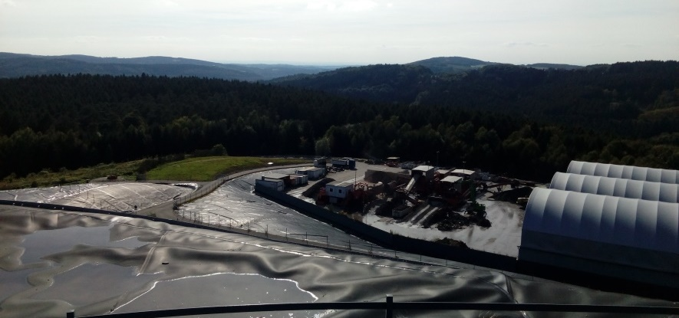
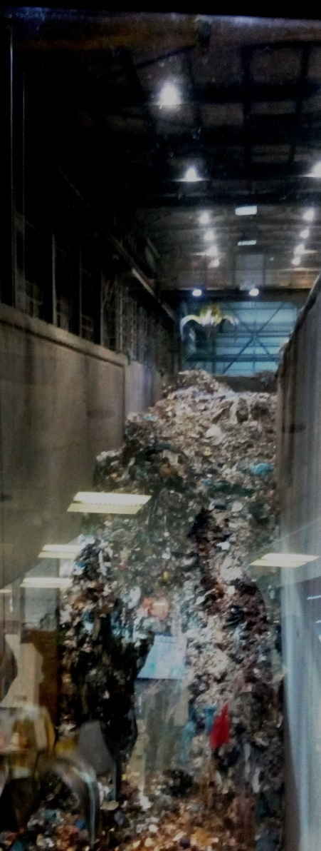
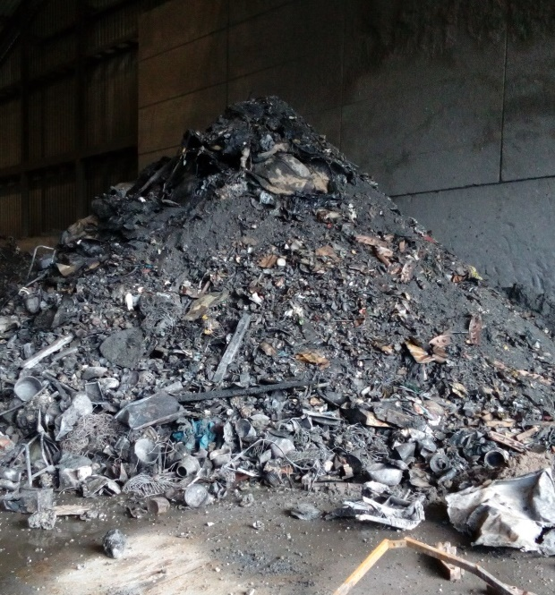
Introduction
MSW
IBA
Landfill
and/or
Aggregates
Mass reduction > 60% wt.

Slide 4
Introduction
MSW
IBA
Landfill
and/or
Aggregates
 | L/S dependence test (L/S = 10 l/kg) |  |  | pH dependence test (L/S = 10 l/kg)
 | Close to the limit | Partially exceeding | Consistently exceeding | Partially exceeding | Consistently exceeding
IBA | Cd, Se, Zn | Cr, Mo, Ni, Pb, Sb, SO4 | Cl, Cu | Cd. Cr, Ni, Pb, Se, Zn | Cl, Cu, Mo, Sb, SO4
Mass reduction > 60% wt.
H. Saveyn, P. Eder, E. Garbarino, L. Muchova, O. Hjelmar, H. van der Sloot, R. Comans, A. van Zomeren, J. Hyks, A. Oberender. Study on methodological aspects regarding limit values for pollutants in aggregates in the context of the possible development of end-of-waste criteria under the EU Waste Framework Directive

Slide 5
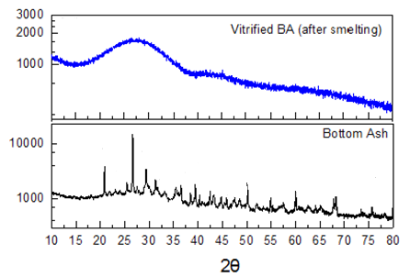
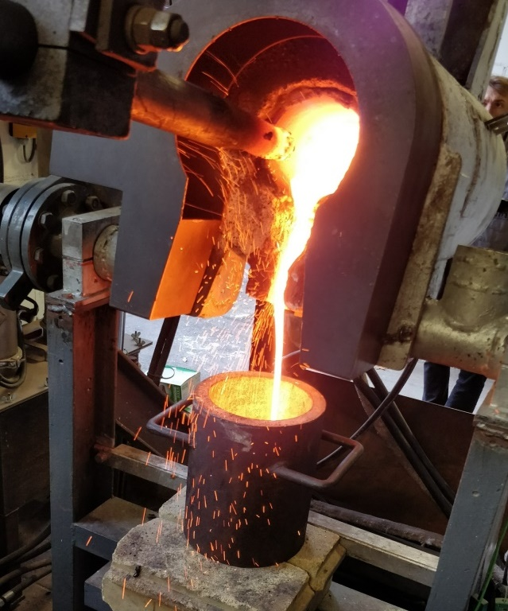
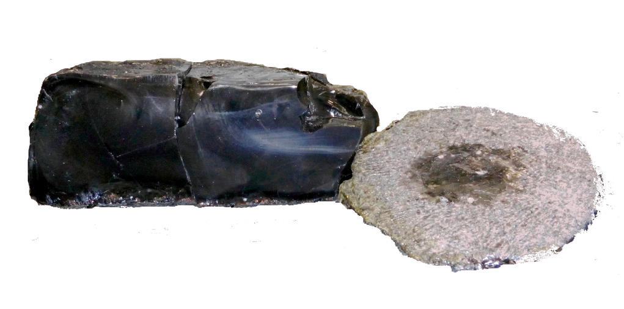
Thermal treatment of IBA
Metal
9-12% IBA
Slag
65-70% IBA
Recovered Metal
75-90 % Fe
5-15 %Cu
Others (Cr, Ni, Ag, Au)
Glass
Slag: ~100% amorphous
45-50% ${SiO}_{2}$
18-21% $CaO$
16-20% ${Al}_{2}O_{3}$
Others:
${Na}_{2}O,, K2O, MgO, etc$.
Recover Metal

Slide 6
Thermal treatment of IBA
Metal
9-12% IBA
Slag
65-70% IBA
Amorphous
Crystalline
Recovered Metal
75-90 % Fe
5-15 %Cu
Others (Cr, Ni, Ag, Au)
Glass
Slag: ~100% amorphous
45-50% ${SiO}_{2}$
18-21% $CaO$
16-20% ${Al}_{2}O_{3}$
Others:
${Na}_{2}O, K2O, MgO, etc.$
Recover Metal
“Vitrified slag free of hazardous elements
(Cr, Mo, Co, Pb, Zn, etc.)

Slide 7
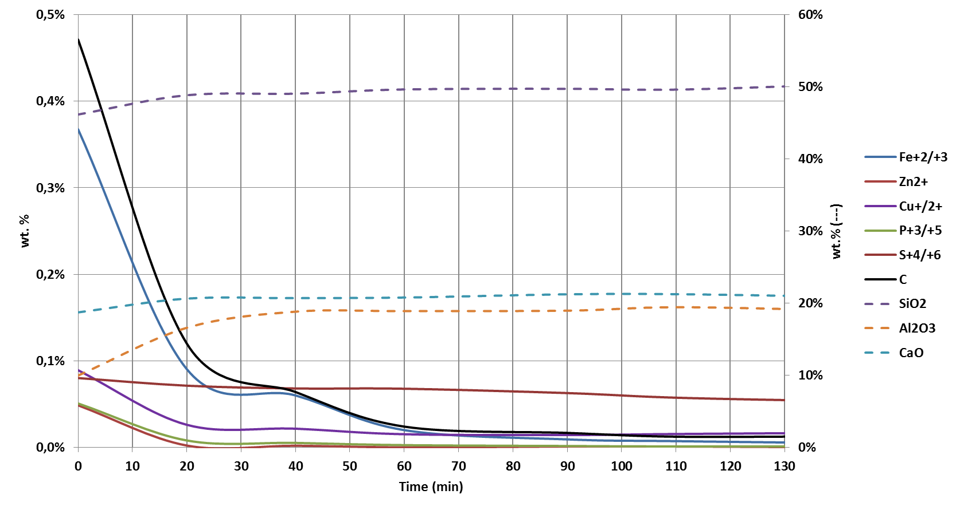
Thermal treatment of IBA
wt.% | SiO₂ | CaO | Al₂O₃ | Na₂O | Fe₂O₃ | ZnO | CuO | PbO | SO₃ | Cl | C
IBA | 39.1 | 23.70 | 8.18 | 3.00 | 7.95 | 0.95 | 0.53 | 0.26 | 2.77 | 1.62 | 5.55
Slag | 48.3 | 22.60 | 18.51 | 3.73 | 0.76 | 0.01 | 0.14 | 0.01 | 1.48 | 0.02 | 0.11
SiO₂
C
Fe
CaO
Al₂O₃
S
P
Zn
Cu

Slide 8
Thermal treatment of IBA
wt.% | SiO₂ | CaO | Al₂O₃ | Na₂O | Fe₂O₃ | ZnO | CuO | PbO | SO₃ | Cl | C
IBA | 39.1 | 23.70 | 8.18 | 3.00 | 7.95 | 0.95 | 0.53 | 0.26 | 2.77 | 1.62 | 5.55
Slag | 48.3 | 22.60 | 18.51 | 3.73 | 0.76 | 0.01 | 0.14 | 0.01 | 1.48 | 0.02 | 0.11
Charging
SiO₂
C
Fe
CaO
Al₂O₃
S
P
Zn
Cu

Slide 9
Thermal treatment of IBA
wt.% | SiO₂ | CaO | Al₂O₃ | Na₂O | Fe₂O₃ | ZnO | CuO | PbO | SO₃ | Cl | C
IBA | 39.1 | 23.70 | 8.18 | 3.00 | 7.95 | 0.95 | 0.53 | 0.26 | 2.77 | 1.62 | 5.55
Slag | 48.3 | 22.60 | 18.51 | 3.73 | 0.76 | 0.01 | 0.14 | 0.01 | 1.48 | 0.02 | 0.11
Charging
SiO₂
C
Fe
CaO
Al₂O₃
S
P
Zn
Cu

Slide 10
Thermal treatment of IBA
wt.% | SiO₂ | CaO | Al₂O₃ | Na₂O | Fe₂O₃ | ZnO | CuO | PbO | SO₃ | Cl | C
IBA | 39.1 | 23.70 | 8.18 | 3.00 | 7.95 | 0.95 | 0.53 | 0.26 | 2.77 | 1.62 | 5.55
Slag | 48.3 | 22.60 | 18.51 | 3.73 | 0.76 | 0.01 | 0.14 | 0.01 | 1.48 | 0.02 | 0.11
Charging
SiO₂
C
Fe
CaO
Al₂O₃
S
P
Zn
Cu

Slide 11
Thermal treatment of IBA
wt.% | SiO₂ | CaO | Al₂O₃ | Na₂O | Fe₂O₃ | ZnO | CuO | PbO | SO₃ | Cl | C
IBA | 39.1 | 23.70 | 8.18 | 3.00 | 7.95 | 0.95 | 0.53 | 0.26 | 2.77 | 1.62 | 5.55
Slag | 48.3 | 22.60 | 18.51 | 3.73 | 0.76 | 0.01 | 0.14 | 0.01 | 1.48 | 0.02 | 0.11
Charging
Conditioning
SiO₂
C
Fe
CaO
Al₂O₃
S
P
Zn
Cu

Slide 12
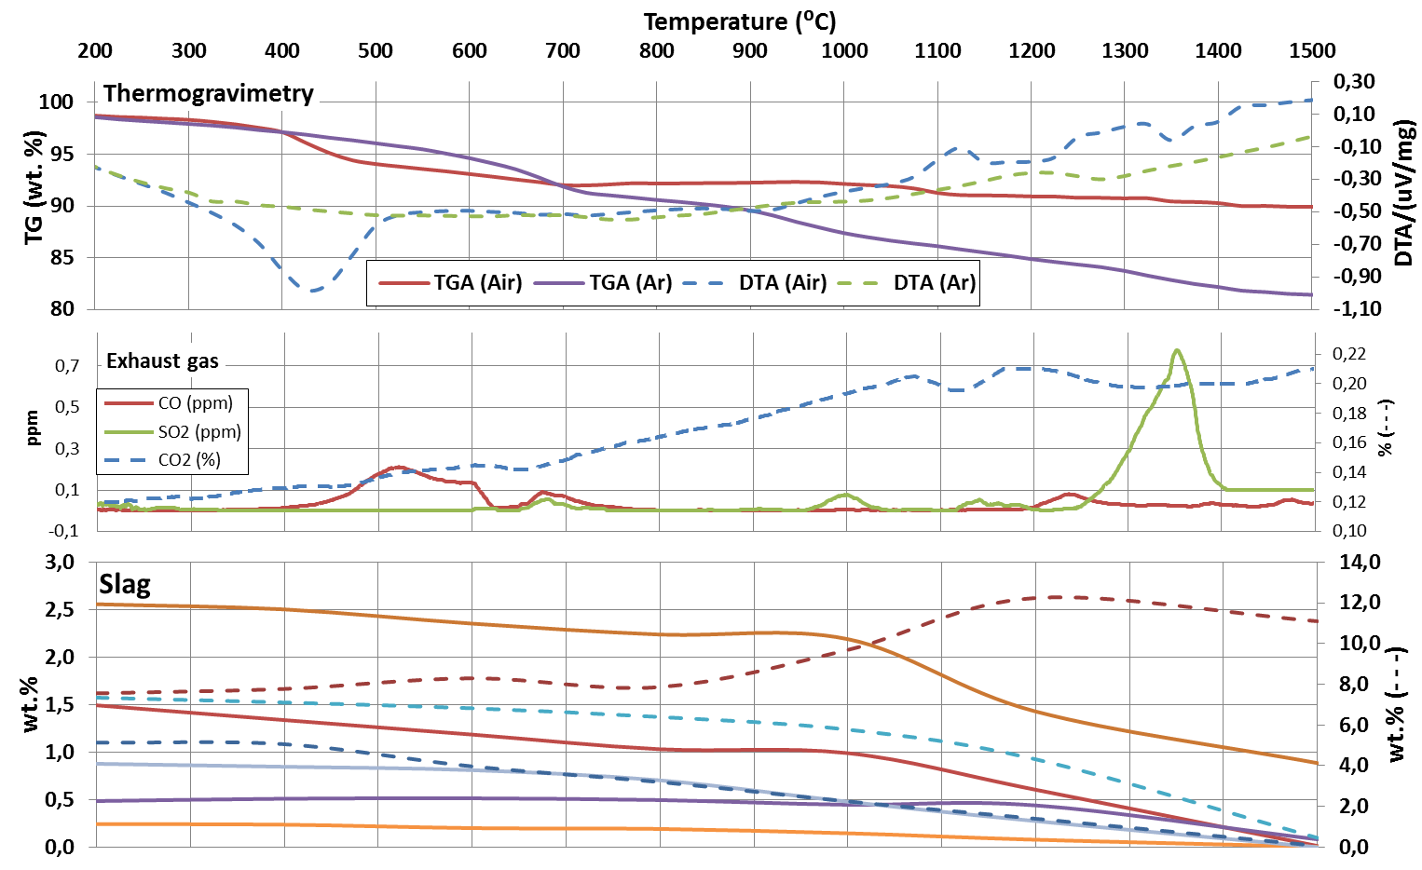
IBA Decomposition
CO₂
CO
SO₂
Al₂O₃
Cl
Fe₂O₃
SO₃
C
ZnO
CuO
PbO

Slide 13
IBA Decomposition
CO₂
CO
SO₂
Al₂O₃
Fe₂O₃
SO₃
C
ZnO
Cl
CuO
PbO
1st phase
2st phase
3rd phase

Slide 14
IBA Decomposition
Carbonates
CO₂
Unburnt
SO₂
Al₂O₃
Cl
Fe₂O₃
SO₃
C
ZnO
CuO
PbO
1st phase
2st phase
3rd phase

Slide 15
IBA Decomposition
CO₂
CO
SO₂
Al₂O₃
Cl
Fe₂O₃
SO₃
C
ZnO
CuO
PbO
1st phase
2st phase
3rd phase

Slide 16
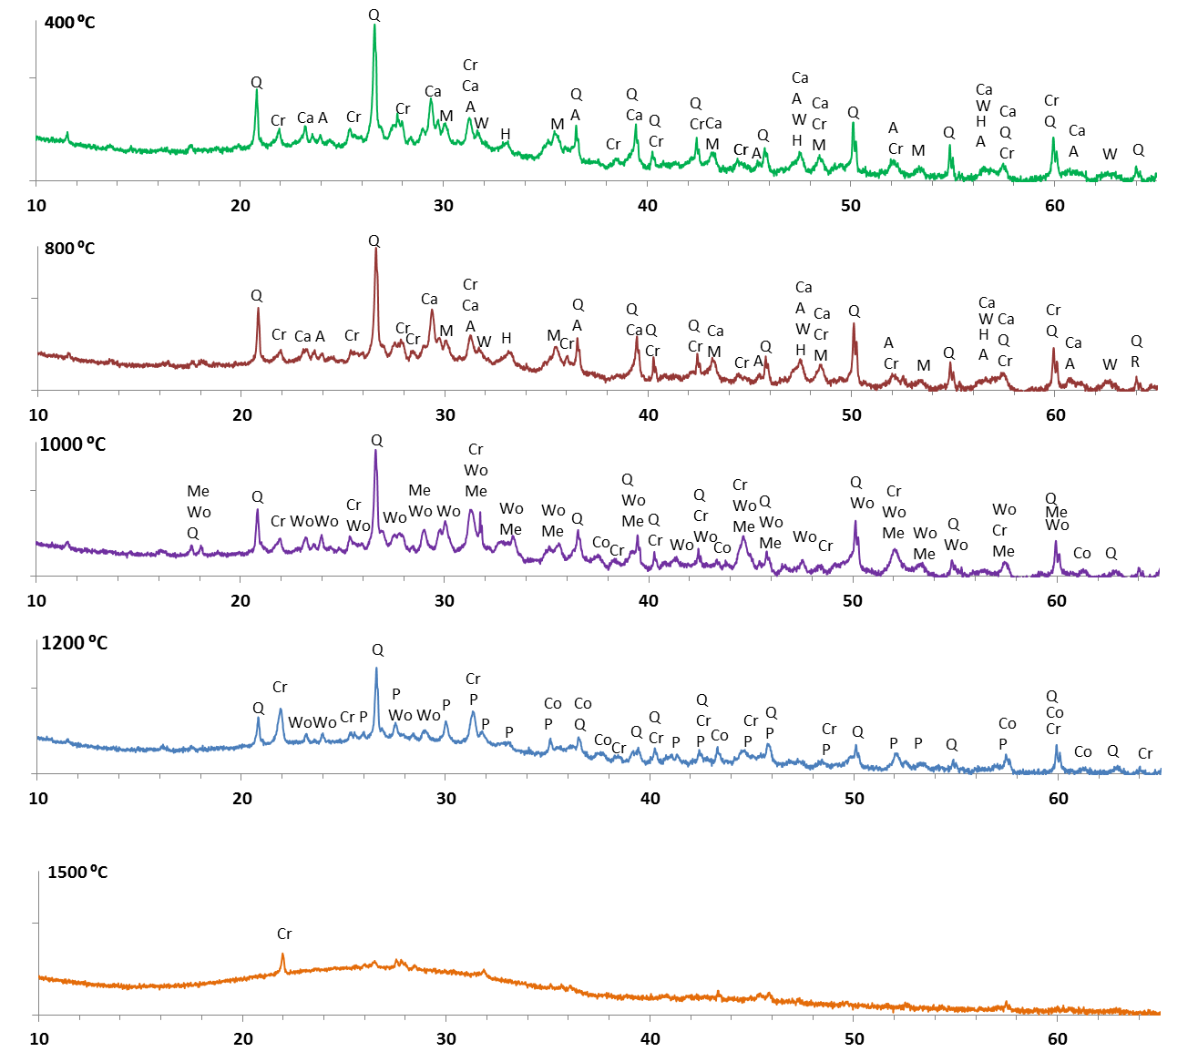
H: Hematite
M: Magnetite
A: Anhydryte
W: Wurtzite
Ca: Calcite
Cr: Cristobalite
Q: Quartz
Co: Corundum
Me: Melilite
Wo: Wollastonite
P: Pseudo-
wollastonite

Slide 17
H: Hematite
M: Magnetite
A: Anhydryte
W: Wurtzite
Ca: Calcite
Cr: Cristobalite
Q: Quartz
Co: Corundum
Me: Melilite
Wo: Wollastonite
P: Pseudo-
wollastonite

Slide 18
IBA Decomposition
CO₂
SO₂
Al₂O₃
Cl
Fe₂O₃
SO₃
C
ZnO
CuO
PbO
1st phase
2st phase
3rd phase

Slide 19
H: Hematite
M: Magnetite
A: Anhydryte
W: Wurtzite
Ca: Calcite
Cr: Cristobalite
Q: Quartz
Co: Corundum
Me: Melilite
Wo: Wollastonite
P: Pseudo-
wollastonite

Slide 20
Outlook/ Conclusions
IBA doesn’t need addition of reductants or fluxing agents to reduce the melting point.
Commercial glass (SiO₂-Na₂O-CaO matrix) + CaO (decomposition of CaCO₃) favours the dissolution of high melting point minerals (quartz, rutile, corundum, etc.).
The range between 800 and 1.300˚C is crucial to cleaning IBA from potentially contaminating pollutants (Cl, Zn, Pb, Cu, Co, Mo).
High temperatures allow to homogenize and separate metals from the slag.
Due to its high silica content, once IBA re-melted, it presents an amorphous and chemically stable structure.

Slide 21
IME Process Metallurgy and Metal Recycling
RWTH Aachen University
Prof. Dr.-Ing. Dr. h.c. Bernd Friedrich
www.ime-aachen.de
hlucas@ime-aachen.de

